Slide 1
ICS 432 – 01 Distributed and Cloud Computing Fall 2021
Instructor: Thanaa Ghanem
thanaa.ghanem@metrostate.edu
Lecture 5
September 25, 2021

Slide 2
Lecture 5: File Systems
File System Concepts
File Systems Interface
File System Implementation
Distributed File System (DFS)
Reading:
Operating System Concepts (9th edition):
*OSC Chapter 11: File System Interface (sections 11.1, 11.4, and 11.5)
*OSC Chapter 12: File System implementation (Sections 12.1,12.2, and 12.8)
Elastic File System in AWS
Lab exercise 1: Working with AWS Elastic File System (AWS EFS)
Reference: AWS EFS Developer Guide
Storage in GCP
Lab exercise 2: Working with Cloud Filestore
Reference: GCP Cloud Filestore Quickstart using the Console.

Slide 3
File System Concepts

Slide 4
Topics to be covered
File System Interface
File System Implementation
Distributed File System

Slide 5
Chapter 11: File-System Interface
11.1 File Concept
11.4 File-System Mounting
11.5 File Sharing

Slide 6
File Concept
A file is basically a contiguous logical address space
Types:
Data
numeric
character
binary
Program
File contents are defined and interpreted by the file’s creator (e.g., application)
Many types: text file, source file, executable file

Slide 7
File Attributes
Name – only information kept in human-readable form
Identifier – unique tag (number) identifies file within file system
Type – needed for systems that support different types
Location – pointer to file location on device
Size – current file size
Protection – controls who can do reading, writing, executing
Time, date, and user identification – data for protection, security, and usage monitoring
Information about files are kept in the directory structure, which is maintained on the disk

Slide 8
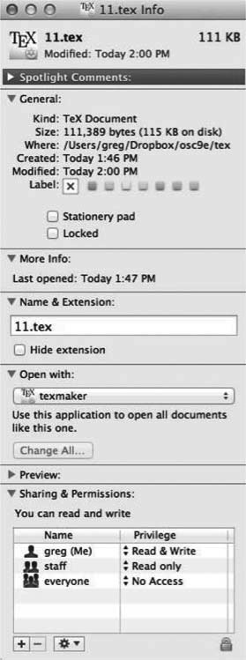
File info Window on Mac OS X

Slide 9
File Operations
File is an abstract data type
Create
Write – at write pointer location
Read – at read pointer location
Reposition within file - seek
Delete
Truncate
Open(F_{i}) – search the directory structure on disk for entry F_{i}, and move the content of entry to memory
Close (F_{i}) – move the content of entry F_{i} in memory to directory structure on disk

Slide 10
Open File
Several pieces of information are associated with an open file
File pointer
File-open count
Disk location of the file
Access rights

Slide 11
Open File Locking
Provided by some operating systems and file systems
Shared lock similar to reader lock – several processes can acquire concurrently
Exclusive lock similar to writer lock
Mediates access to a file
Mandatory or advisory:
Mandatory – access is denied depending on locks held and requested
Advisory – processes can find status of locks and decide what to do

Slide 12
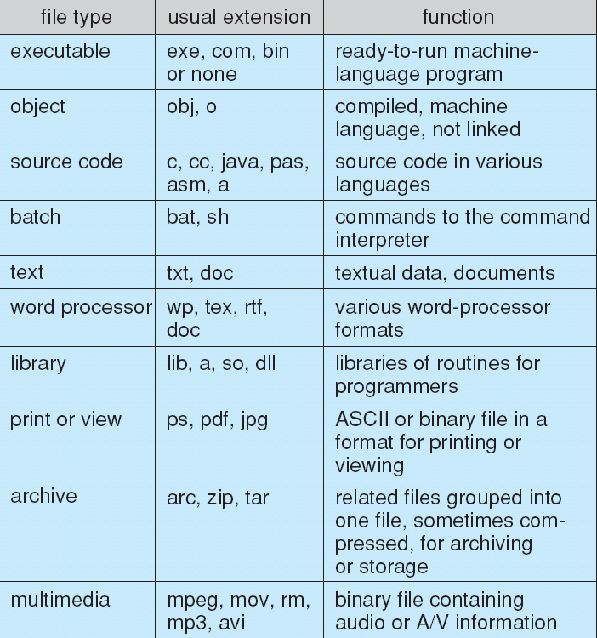
File Types – Name, Extension

Slide 13
File Structure
None - sequence of words, bytes
Simple record structure
Lines
Fixed length
Variable length
Complex Structures
Formatted document
Relocatable load file
Can simulate last two with first method by inserting appropriate control characters
Who decides:
Operating system – an OS may define a set of system-supported file structures
Program

Slide 14
Directory Structure
A collection of nodes containing information about all files
Directory
Files
F 1
F 2
F 3
F 4
F n
Both the directory structure and the files reside on disk

Slide 15
Disk Structure
Disk can be subdivided into partitions
Disks or partitions can be RAID protected against failure
Disk or partition can be used either
raw – without a file system, or
formatted with a file system
Partitions also known as minidisks, slices
The disk Entity containing file system known as a volume
Each volume containing a file system also tracks that file system’s info in device directory or volume table of contents
As well as general-purpose file systems there are many special-purpose file systems, frequently all within the same operating system or computer

Slide 16
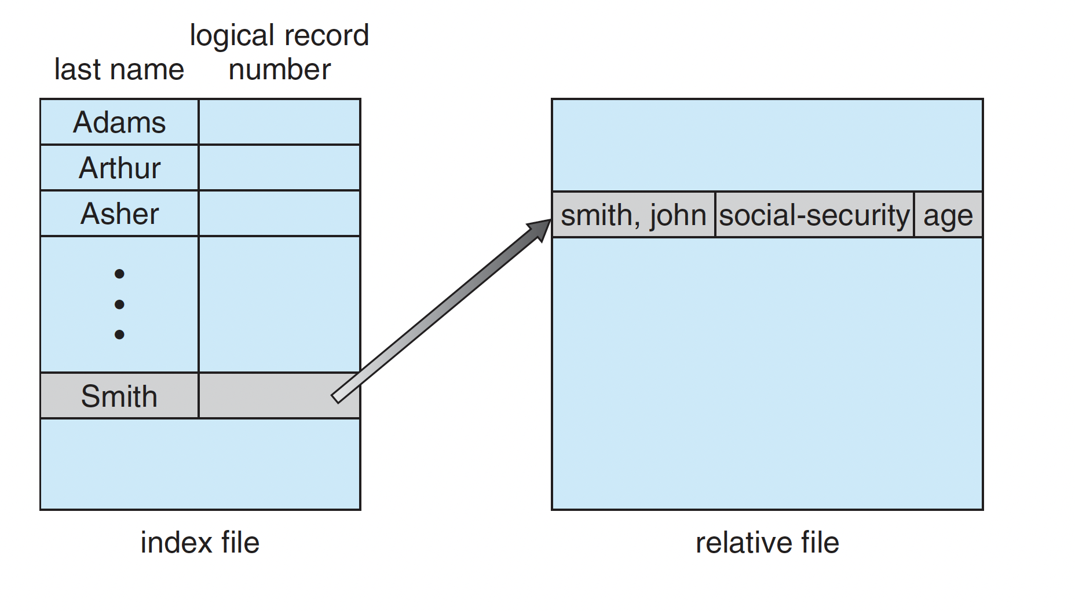

Slide 17
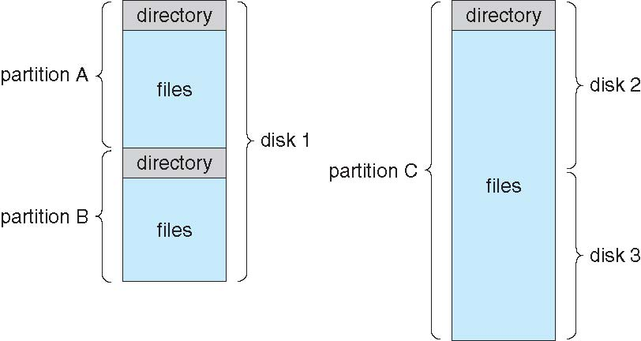
A Typical File-system Organization

Slide 18
Operations Performed on Directory
Search for a file
Create a file
Delete a file
List a directory
Rename a file
Traverse the file system

Slide 19
Directory Organization
The directory is organized logically to obtain
Efficiency – locating a file quickly
Naming – convenient to users
Two users can have same name for different files
The same file can have several different names
Grouping – logical grouping of files by properties, (e.g., all Java programs, all games, …)

Slide 20
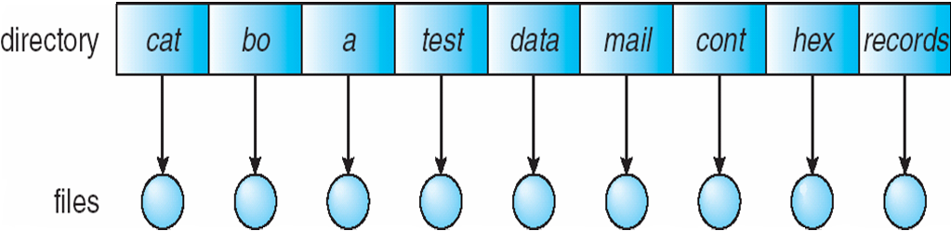
Single-Level Directory
A single directory for all users
Naming problem
Grouping problem

Slide 21
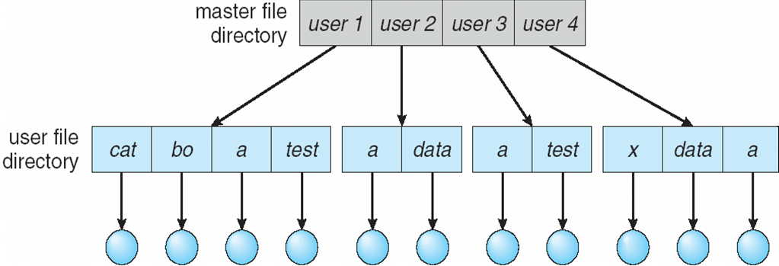
Two-Level Directory
Separate directory for each user
Path name
Can have the same file name for different user
Efficient searching
No grouping capability

Slide 22
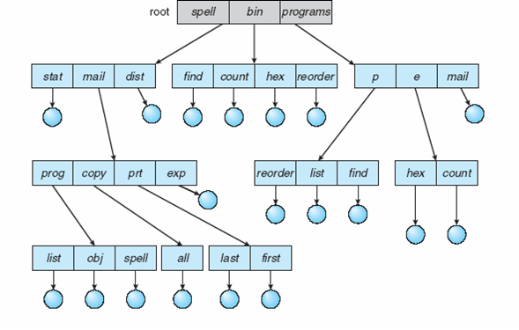
Tree-Structured Directories

Slide 23
Tree-Structured Directories (Cont.)
Efficient searching
Grouping Capability
Current directory (working directory)
cd /spell/mail/prog
type list

Slide 24
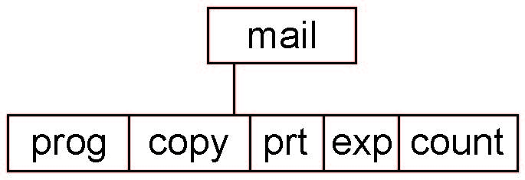
Tree-Structured Directories (Cont)
Absolute or relative path name
Creating a new file is done in current directory
Delete a file
rm <file-name>
Creating a new subdirectory is done in current directory
mkdir <dir-name>
Example: if in current directory /mail
mkdir count
Deleting “mail” ⇒ deleting the entire subtree rooted by “mail”

Slide 25
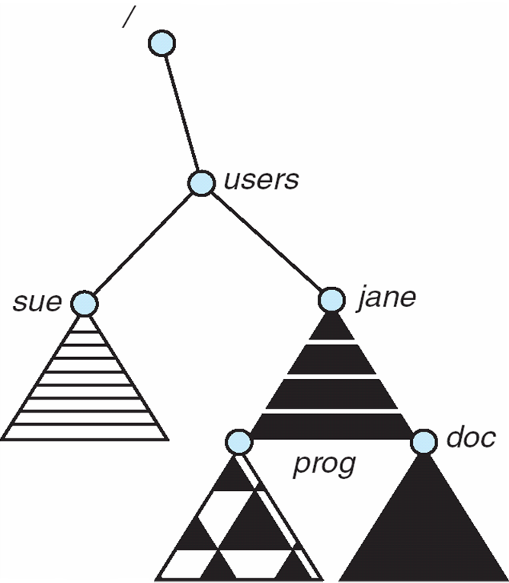
File System Mounting
A file system must be mounted before it can be accessed
A unmounted file system (i.e., Fig b) is mounted at a mount point (e.g., /users)
➔

Slide 26
File Sharing
Sharing of files on multi-user systems is desirable
Challenge in File sharing:
Conflicting actions occurring on a shared file (e.g., multiple users writing to the file simultaneously).
Sharing may be done through a protection scheme
On distributed systems, files may be shared across a network
Network File System (NFS) is a common distributed file-sharing method

Slide 27
File Sharing – Multiple Users
Two choices for the system:
allowing one user to access other user’s files by default
requires explicit access grants
System maintain more file and directory structures
If multi-user system
User IDs identify users, allowing permissions and protections to be per-user Group IDs allow users to be in groups, permitting group access rights
Owner of a file / directory
Group of a file / directory

Slide 28
File Sharing – Remote File Systems
Uses networking to allow file system access between systems
Manually via programs like FTP
Automatically, seamlessly using distributed file systems (DFS)
Semi automatically via the world wide web
DFS involves much tighter integration between the machine accessing the file and the machine providing the file
This integration adds complexity.

Slide 29
File Sharing – Client-server model
Client-server model allows clients to mount remote file systems from servers
Server can serve multiple clients
Client and user-on-client identification is insecure or complicated
NFS is standard UNIX client-server file sharing protocol
CIFS is standard Windows protocol
Standard operating system file calls are translated into remote calls
Spoofing – unauthorized client gets access to the files.
DFS protocol -- once the remote file system is mounted, file operation request are sent by the client across the network to the server.

Slide 30
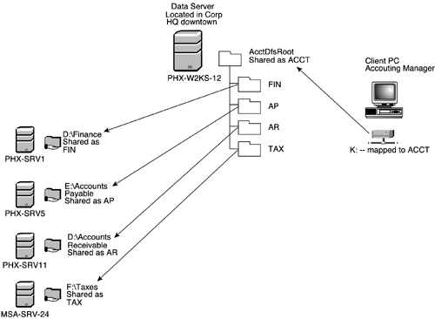
DFS Architecture

Slide 31
File sharing – Distributed Information Systems
Distributed Information Systems (distributed naming services) such as LDAP, DNS, NIS, Active Directory implement unified access to information needed for remote computing
Domain Name System (DNS) – provides host-name-to-domain-address translations.
Microsoft Common Internet File System (CIFS) – network information is used in conjunction with user authentication (user name and password) to create a network login that the server uses to decide whether to allow or deny access to a requested file system

Slide 32
File sharing -- Failure Modes
Local file systems failure: hardware, software corruption, cable or disk failures.
Remote file system:
network failures is an additional concern
network partitioning may take place in the middle of a file operation.
scheduled shut down of the server.
Failure semantics are defined and implemented as part of the DFS protocol.
State information is needed to recover from failure.
both server and client maintain knowledge of their current activities and open files, then they can seamlessly recover from a failure.

Slide 33
File Sharing – Consistency Semantics
File session: the series of file accesses between the open() and close() operations.
Consistency semantics specify how multiple users are to access a shared file simultaneously:
specify when modifications of data by one user will be observable by other users.

Slide 34
Consistency Semantics
Three possible consistency semantics:
Unix file system (UFS) implements:
Writes to an open file visible immediately to other users of the same open file
Sharing file pointer to allow multiple users to read and write concurrently
Andrew File System (AFS) has session semantics
Writes to an open file by a user are not visible immediately to other users that have the same file open.
Once a file is closed, the changes made to it are visible only in sessions starting later. Already open instances of the file do not reflect these changes.
Immutable-shared-files semantics:
Shared files cannot be modified.

Slide 35
Protection
File owner/creator should be able to control:
what can be done
by whom
Types of access
Read
Write
Execute
Append
Delete
List

Slide 36
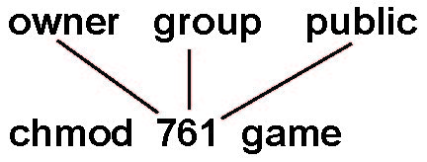
Access Lists and Groups
Mode of access: read, write, execute
Three classes of users on Unix / Linux
RWX
a) owner access 7 ⇒ 1 1 1 RWX
b) group access 6 ⇒ 1 1 0
RWX
c) public access 1 ⇒ 0 0 1
Ask manager to create a group (unique name), say G, and add some users to the group.
For a particular file (say game) or subdirectory, define an appropriate access.
Attach a group to a file chgrp G game

Slide 37
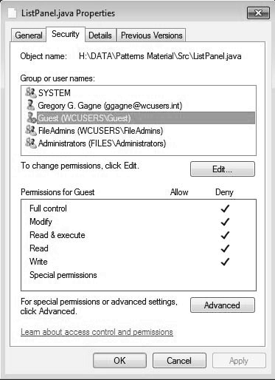
Windows 7 Access-Control List Management

Slide 38
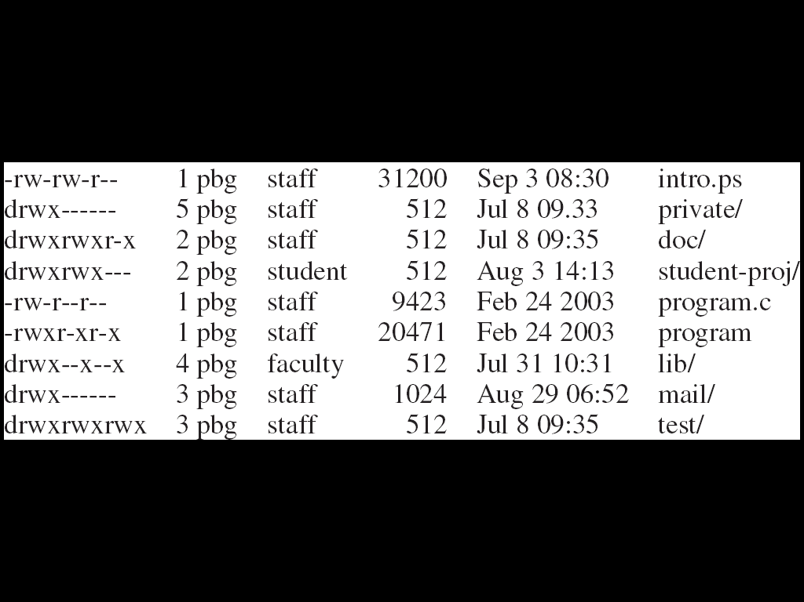
A Sample UNIX Directory Listing

Slide 39
Chapter 12: File System Implementation
12.1 File System Structure
12.2 File System Implementation
12.8 Network File System (NFS)

Slide 40
Objectives
To describe the details of implementing local file systems and directory structures
To describe the implementation of remote file systems

Slide 41
File-System Structure
File structure
Logical storage unit
Collection of related information
File system resides on secondary storage (disks)
Provides user interface to storage, mapping logical to physical
Provides efficient and convenient access to disk by allowing data to be stored, located retrieved easily
Disk provides in-place rewrite and random access
I/O transfers performed in blocks of sectors (usually 512 bytes)
File control block – storage structure consisting of information about a file
Device driver controls the physical device
File system organized into layers

Slide 42
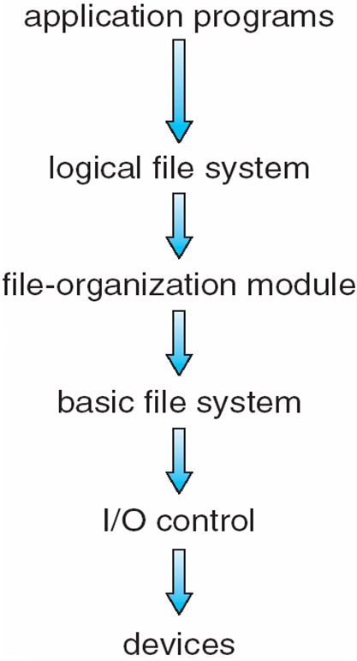
Layered File System

Slide 43
File System Layers
Device drivers manage I/O devices at the I/O control layer
Given commands like “read drive1, cylinder 72, track 2, sector 10, into memory location 1060” outputs low-level hardware specific commands to hardware controller
Basic file system given command like “retrieve block 123” translates to device driver
Also manages memory buffers and caches (allocation, freeing, replacement) Buffers hold data in transit
Caches hold frequently used data
File organization module understands files, logical address, and physical blocks
Translates logical block # to physical block #
Manages free space, disk allocation

Slide 44
File System Layers (cont.)
Logical file system manages metadata information
Translates file name into file number, file handle, location by maintaining file control blocks (inodes in UNIX)
Directory management
Protection
Logical layers can be implemented by any coding method according to OS designer
Layering useful for reducing complexity and redundancy, but adds overhead and can decrease performance

Slide 45
File System Layers (cont.)
Many file systems, sometimes many within an operating system
Each with its own format :
CD-ROM is ISO 9660;
Unix has UFS, FFS;
Windows has FAT, FAT32, NTFS as well as floppy, CD, DVD Blu-ray,
Linux has more than 40 types, with extended file system ext2 and ext3 leading;
distributed file systems.
New ones still arriving – ZFS, GoogleFS, Oracle ASM, FUSE

Slide 46
File-System Implementation
We have system calls at the API level, but how do we implement their functions?
uses on-disk and in-memory data structures
Boot control block contains info needed by system to boot OS from that volume
Needed if volume contains OS, usually first block of volume
Volume control block (superblock, master file table) contains volume details
Total # of blocks, # of free blocks, block size, free block pointers or array
Directory structure organizes the files
Names and inode numbers, master file table

Slide 47
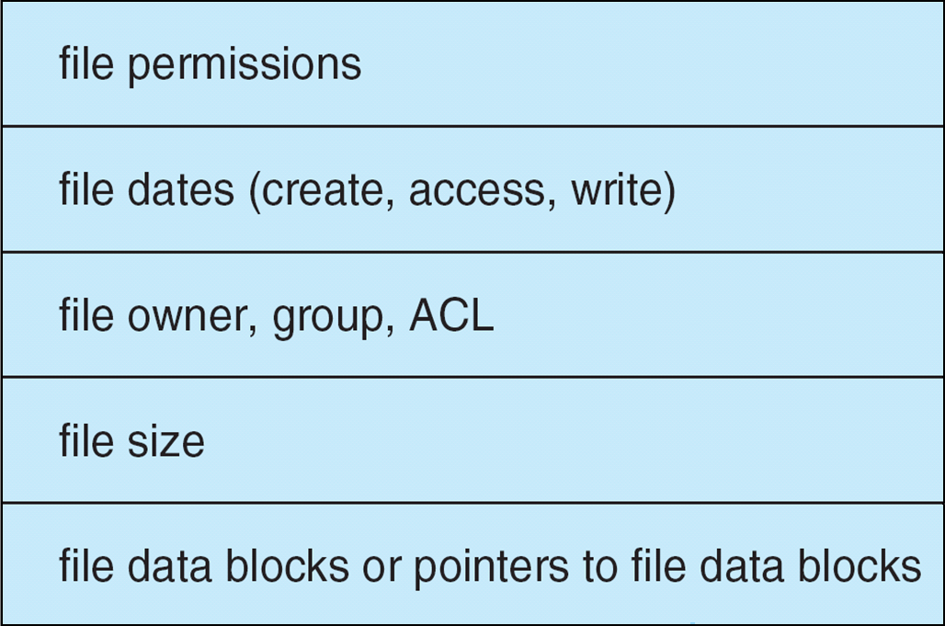
File-System Implementation (Cont.)
Per-file File Control Block (FCB) contains many details about the file
inode number, permissions, size, dates
NFTS stores into in master file table using relational DB structures

Slide 48
In-Memory File System Structures
Mount table storing file system mounts, mount points, file system types
The following figure illustrates the necessary file system structures provided by the operating systems
Buffers are used to hold data blocks from secondary storage
Open returns a file handle for subsequent use
Data from read eventually copied to specified user process memory address

Slide 49
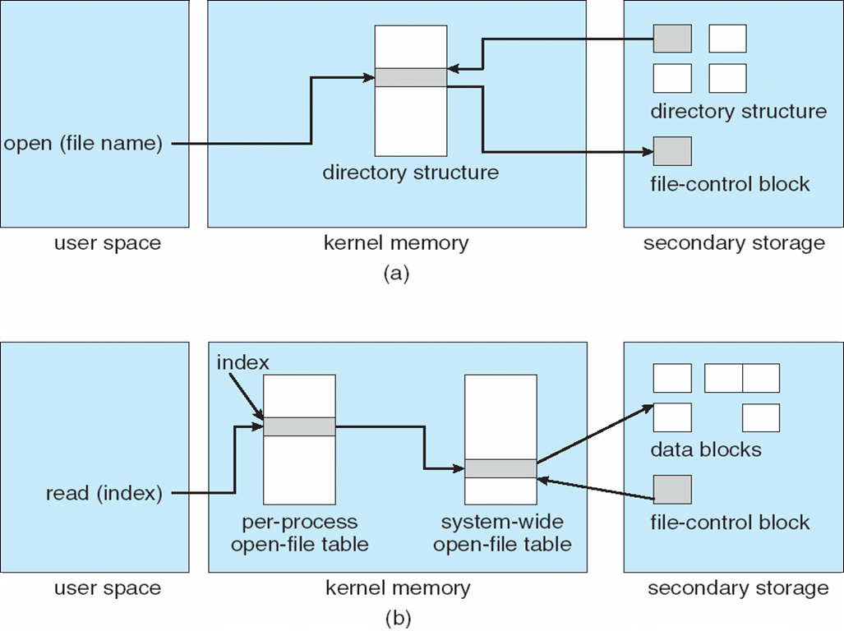
In-Memory File System Structures
Opening a file:
Reading a file:

Slide 50
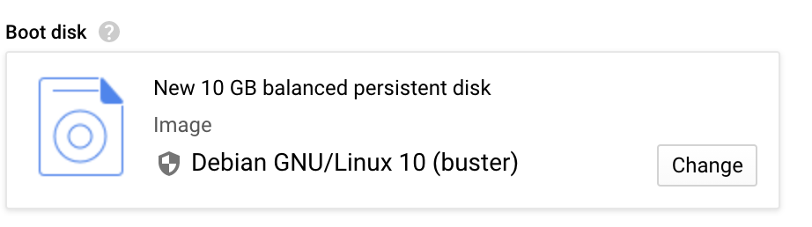
Partitions and Mounting
A disk Partition can be a volume containing a file system (“cooked”) or raw – just a sequence of blocks with no file system
Boot block can point to boot volume or boot loader set of blocks that contain enough code to know how to load the kernel from the file system
Root partition contains the OS, other partitions can hold other operating systems, file systems, or be raw
Mounted at boot time
Other partitions can mount automatically
or manually
At mount time, file system consistency checked
Is all metadata correct?
If not, fix it, try again
If yes, add to mount table, allow access

Slide 51
Amazon EBS
Amazon EBS enables you to create individual storage volumes and attach them to an Amazon EC2 instance:
Amazon EBS offers block-level storage.
Volumes are automatically replicated within its Availability Zone.
It can be backed up automatically to Amazon S3 through snapshots.
Uses include –
Boot volumes and storage for Amazon Elastic Compute Cloud (Amazon EC2) instances
Data storage with a file system
Database hosts
Enterprise applications
Notes:
Amazon EBS enables you to create individual storage volumes and attach them to an Amazon EC2 instance. Amazon EBS offers block-level storage, where its volumes are automatically replicated within its Availability Zone. Amazon EBS is designed to provide durable, detachable, block-level storage (which is like an external hard drive) for your Amazon EC2 instances. Because they are directly attached to the instances, they can provide low latency between where the data is stored and where it might be used on the instance.
For this reason, they can be used to run a database with an Amazon EC2 instance. Amazon EBS volumes are included as part of the backup of your instances into Amazon Machine Images (or AMIs). AMIs are stored in Amazon S3 and can be reused to create new Amazon EC2 instances later.
A backup of an Amazon EBS volume is called a snapshot. The first snapshot is called the baseline snapshot. Any other snapshot after the baseline captures only what is different from the previous snapshot.
Amazon EBS volumes uses include:
Boot volumes and storage for Amazon EC2 instances
Data storage with a file system
Database hosts
Enterprise applications

Slide 52
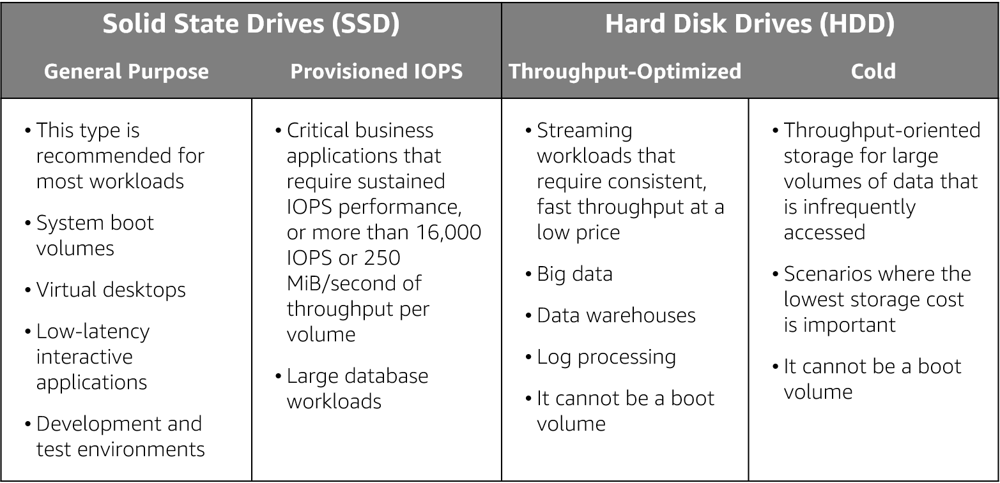
Amazon EBS volume type use cases
Notes:
As mentioned previously an Amazon EBS volume is a durable, block-level storage device that you can attach to a single EC2 instance. You can use Amazon EBS volumes as primary storage for data that requires frequent updates, such as the system drive for an instance or storage for a database application. You can also use them for throughput-intensive applications that perform continuous disk scans. Amazon EBS volumes persist independently from the running life of an EC2 instance.
Use cases for EBS vary by the storage type used and whether you are using General Purpose of Provisioned IOPS.

Slide 53
Directory Implementation
Linear list of file names with pointer to the data blocks
Simple to program
Time-consuming to execute
Linear search time
Could keep ordered alphabetically via linked list or use B+ tree
Hash Table – linear list with hash data structure
Decreases directory search time
Collisions – situations where two file names hash to the same location
Only good if entries are fixed size, or use chained-overflow method

Slide 54
Allocation Methods - Contiguous
An allocation method refers to how disk blocks are allocated for files:
Contiguous allocation – each file occupies set of contiguous blocks
Best performance in most cases
Simple – only starting location (block #) and length (number of blocks) are required
Problems include finding space for file, knowing file size, external fragmentation, need for compaction off-line (downtime) or on-line

Slide 55
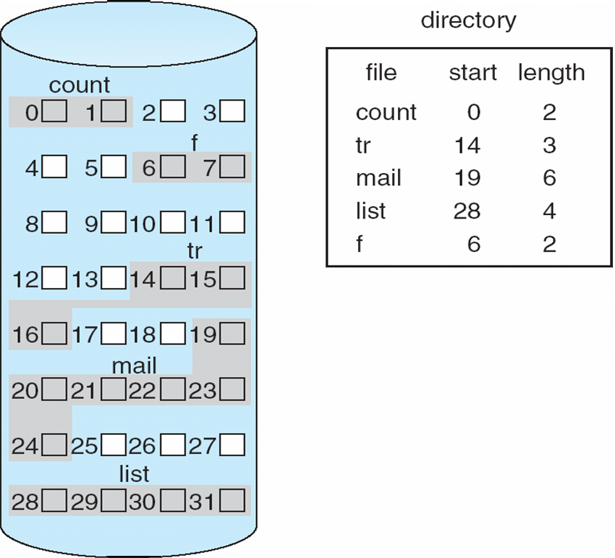
Contiguous Allocation
Mapping from logical to physical
Q
LA/512
R
Block to be accessed = Q + starting address
Displacement into block = R

Slide 56
Allocation Methods - Linked
Linked allocation – each file a linked list of blocks
File ends at nil pointer
No external fragmentation
Each block contains pointer to next block
No compaction, external fragmentation
Free space management system called when new block needed
Improve efficiency by clustering blocks into groups but increases internal fragmentation
Reliability can be a problem
Locating a block can take many I/Os and disk seeks

Slide 57
Allocation Methods – Linked (Cont.)
FAT (File Allocation Table) variation
Beginning of volume has table, indexed by block number
Much like a linked list, but faster on disk and cacheable
New block allocation simple

Slide 58
Linked Allocation
Each file is a linked list of disk blocks: blocks may be scattered anywhere on the disk
block =
pointer
Mapping
Q
LA/511
R
Block to be accessed is the Qth block in the linked chain of blocks representing the file.
Displacement into block = R + 1

Slide 59
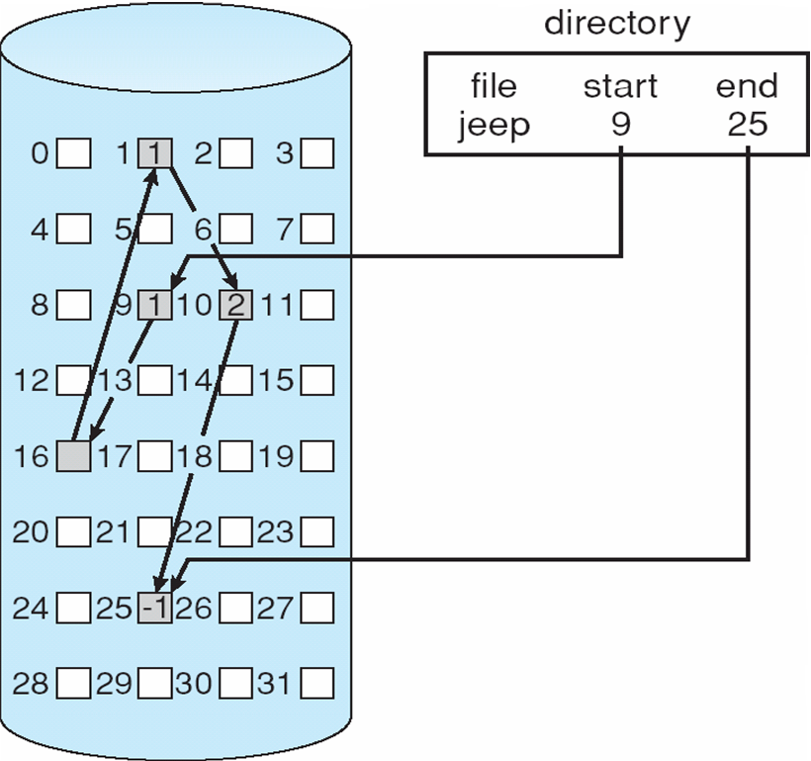
Linked Allocation

Slide 60
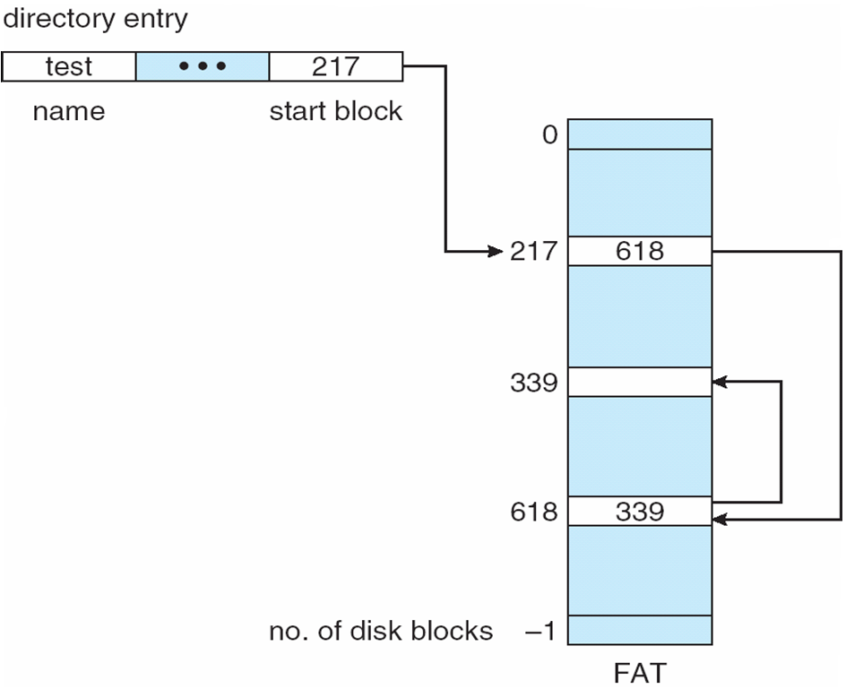
File-Allocation Table (FAT)

Slide 61
Allocation Methods - Indexed
Indexed allocation
Each file has its own index block(s) of pointers to its data blocks
Logical view

Slide 62
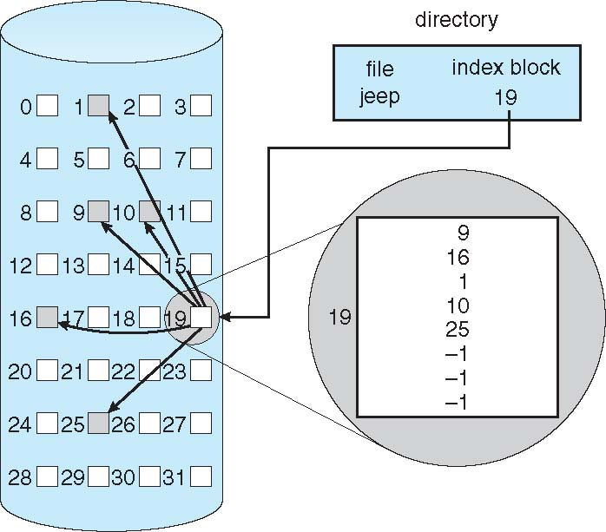
Example of Indexed Allocation

Slide 63

Distributed File System (DFS)
Read File
Network
Data
Client
Server
Example:
Network File System (NFS) -- the most common UNIX-based DFS.
DFS structure consists of:
A service -- a software entity running on one or more machines and providing a particular type of function to clients.
A server -- the service software running on a single machine.
A client -- a process that can invoke a service using a set of operations that form its client interface.
A client interface is formed by a set of primitive file operations like create, delete, read, and write.
A file system provides file services to clients.
The primary hardware component that a file server controls is a set of local secondary-storage devices (usually, magnetic disks) on which files are stored and from which they are retrieved according to the clients’ requests.

Slide 64
DFS (continued)
A DFS is a file system whose clients, servers, and storage devices are dispersed among the machines of a distributed system.
Service activity has to be carried out across the network.
A DFS can be implemented by a software layer and a protocol whose task is to manage the communication between conventional operating systems and file systems.

Slide 65
How DFS are different from FS?
The multiplicity and autonomy of clients and servers in the system.
the client interface of a DFS should not distinguish between local and remote files.
It is up to the DFS to locate the files and to arrange for the transport of the data.
A transparent DFS facilitates user mobility by bringing a user’s environment (that is, home directory) to wherever the user logs in.
Performance measure of a DFS is the amount of time needed to satisfy service requests: disk access + network transfer
In conventional systems, this time consists of disk-access time and a small amount of CPU-processing time.
In DFS, add the time to deliver the request to a server, as well as the time to get the response across the network back to the client. For each direction, in addition to the transfer of the information, there is the CPU overhead of running the communication protocol software.

Slide 66
DFS Architecture

Slide 67
Challenges in DFS
Naming for Transparent Access:
Users see single global file system regardless of location
Performance:
Performance should not degrade because of using the network
Consistency:
See similar directory and file contents on different clients at the same time
Fault tolerant:
Server identify and respond appropriately to crashes
Tension across these goals:
Example: caching helps performance but hurts consistency

Slide 68
Challenges in DFS (1/4): Naming
Naming is a mapping between logical and physical objects.
users deal with logical data objects represented by file names, whereas the system manipulates physical blocks of data stored on disk tracks.
multilevel mapping provides users with an abstraction of a file that hides the details of how and where on the disk the file is stored.
In a transparent DFS, a new dimension is added to the abstraction: that of hiding where in the network the file is located.
File replication: given a file name, the mapping returns a set of the locations of this file’s replicas. In this abstraction, both the existence of multiple copies and their locations are hidden.

Slide 69
Naming Structures
Location transparency. The name of a file does not reveal any hint of the file’s physical storage location.
File name still demotes a specific, although hidden, physical disk blocks.
Convenient way to share data
Location independence. The name of a file does not need to be changed when the file’s physical storage location changes.
better file abstraction
separates the naming hierarchy from the storage-devices hirarchy
Amazon’s EBS cloud storage facility provides blocks of storage on demand via APIs, placing the storage where it sees fit and moving the data as necessary to meet performance, reliability, and capacity requirements.

Slide 70
Naming Schemes
File names include server and local path (URLs)
E.g., http://server.stanford.edu/home/dm – unique name
Variation: Include cryptographically secure name for server
Attach remote directories to local directories (NFS)
Gives appearance of a coherent directory tree
Only previously mounted remote directories accessible
Total integration of the component file systems (AFS)
A single global name structure spans all the files in the system
If a server is unavailable, some arbitrary set of directories on different machines also becomes unavailable
Name by the data you want (Chord CFS, IVY)
Very non-standard administrative model (impractical?)
Some big advantages like scalability & fault tolerance

Slide 71
Challenges in DFS (2/4): Performance Use of caching to reduce network load
read(f1)
→V1
Read (RPC)
read(f1)→V1
cache
read(f1)→V1
Return (Data)
F1:V1
read(f1)→V1
Client
Write (RPC)
cache
F1:V1
F1:V2
ACK
cache
write(f1)
→OK
F1:V2
read(f1)→V2
Client
Server
Idea: Use caching to reduce network load
In practice: use buffer cache at source and destination
Advantage: if open/read/write/close can be done locally, don’t need to do any network traffic…fast!
Problems:
Failure:
Client caches have data not committed at server
Cache consistency!
Client caches not consistent with server/each other

Slide 72
Challenges in DFS (3/4): Consistency
Problem: Consistency across multiple copies (server and multiple clients)
How to keep data consistent between client and server?
If file is changed on server, will client see update?
Determining factor: Read policy on clients
How to keep data consistent across clients?
If write file on client A and read on client B, will B see the updates?

Slide 73
Challenges in DFS (4/4): Failures
Crash!
What if server crashes? Can client wait until server comes back up and continue as before?
Any data in server memory but not on disk can be lost
Shared state across RPC: What if server crashes after seek? Then, when client does “read”, it will fail
Message retries: suppose server crashes after it does UNIX “rm foo”, but before acknowledgment?
Message system will retry: send it again
How does it know not to delete it again? (could solve with two-phase commit protocol, but NFS takes a more ad hoc approach)
Stateless protocol: A protocol in which all information required to process a request is passed with request
Server keeps no state about client, except as hints to help improve performance (e.g. a cache)
Thus, if server crashes and restarted, requests can continue where left off (in many cases)
What if client crashes?
Might lose modified data in client cache

Slide 74
An example DFS: The Sun Network File System (NFS)
An implementation and a specification of a software system for accessing remote files across LANs (or WANs)
The implementation is part of the Solaris and SunOS operating systems running on Sun workstations using an unreliable datagram protocol (UDP/IP) protocol and Ethernet

Slide 75
NFS (Cont.)
Interconnected workstations viewed as a set of independent machines with independent file systems, which allows sharing among these file systems in a transparent manner
A remote directory is mounted over a local file system directory
The mounted directory looks like an integral subtree of the local file system, replacing the subtree descending from the local directory
Specification of the remote directory for the mount operation is nontransparent; the host name of the remote directory has to be provided
Files in the remote directory can then be accessed in a transparent manner
Subject to access-rights accreditation, potentially any file system (or directory within a file system), can be mounted remotely on top of any local directory

Slide 76
NFS protocol is Stateless
NFS servers are stateless; each request has to provide a full set of arguments.
Servers do not maintain information about their clients from one access to another.
No open-file table or file structures at the server side.
Statelessness is important to recover a server after a crash.

Slide 77
File operations are Idempotent
File operations are idempotent which means the same operation performed multiple times has the same effect as it it were performed only once.
To achieve idempotence, every NFS request has a sequence number, allowing the server to determine if a request has been duplicated of if any are missing.

Slide 78
NFS Protocol
NFS is designed to operate in a heterogeneous environment of different machines, operating systems, and network architectures; the NFS specifications independent of these media
This independence is achieved through the use of RPC primitives built on top of an External Data Representation (XDR) protocol used between two implementation-independent interfaces
Two separate protocols are specified:
A mount protocol
NFS protocol for remote file access

Slide 79
NFS Mount Protocol
Establishes initial logical connection between server and client
Mount operation includes name of remote directory to be mounted and name of server machine storing it
When a server receives a mount request that conforms to its export list, the server returns to the client a file handle—a key for further accesses.
File handle – a file-system identifier, and an inode number to identify the mounted directory within the exported file system.
The mount operation changes only the user’s view and does not affect the server side

Slide 80
NFS Protocol
Provides a set of remote procedure calls for remote file operations that can be invoked after a file handle for the remotely mounted directory has been established.
The NFS protocol support the following operations:
searching for a file within a directory
reading a set of directory entries
manipulating links and directories
accessing file attributes
reading and writing files

Slide 81
Three Major Layers of NFS Architecture
UNIX file-system interface (based on the open, read, write, and close calls, and file descriptors)
Virtual File System (VFS) layer – distinguishes local files from remote ones, and local files are further distinguished according to their file-system types
The VFS activates file-system-specific operations to handle local requests according to their file-system types
Calls the NFS protocol procedures for remote requests
NFS service layer – bottom layer of the architecture
Implements the NFS protocol

Slide 82
DFS Implementation: Virtual File Systems
Virtual File Systems (VFS) on Unix provide an object-oriented way of implementing file systems
VFS allows the same system call interface (the API) to be used for different types of file systems
Separates file-system generic operations from implementation details
Implementation can be one of many file systems types, or network file system
Implements vnodes which hold inodes or network file details
Then dispatches operation to appropriate file system implementation routines

Slide 83
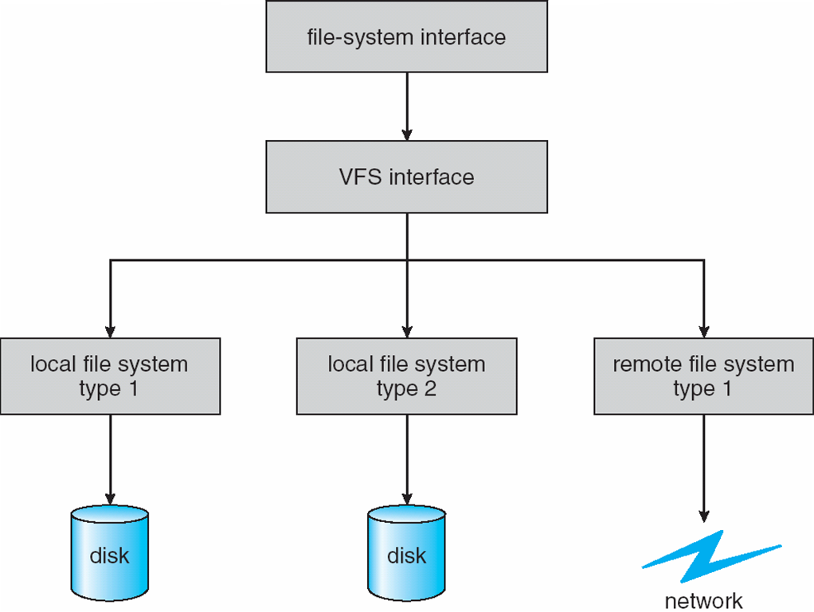
Virtual File Systems (Cont.)
The API is to the VFS interface, rather than any specific type of file system

Slide 84
Virtual File System Implementation
For example, Linux has four object types:
inode, file, superblock, dentry
VFS defines set of operations on the objects that must be implemented
Every object has a pointer to a function table
Function table has addresses of routines to implement that function on that object
For example:
• int open(. . .)—Open a file
• int close(. . .)—Close an already-open file
• ssize t read(. . .)—Read from a file
• ssize t write(. . .)—Write to a file
• int mmap(. . .)—Memory-map a file

Slide 85
Remote File Access
When a user requests access to a remote file. The server storing the file has been located by the naming scheme, and now the actual data transfer must take place.
To ensure reasonable performance of a remote-service mechanism, we can use a form of caching.
The idea is to retain recently accessed disk blocks in the cache, so that repeated accesses to the same information can be handled locally, without additional network traffic.
In conventional file systems, the rationale for caching is to reduce disk I/O (thereby increasing performance), whereas in DFSs, the goal is to reduce both network traffic and disk I/O.

Slide 86
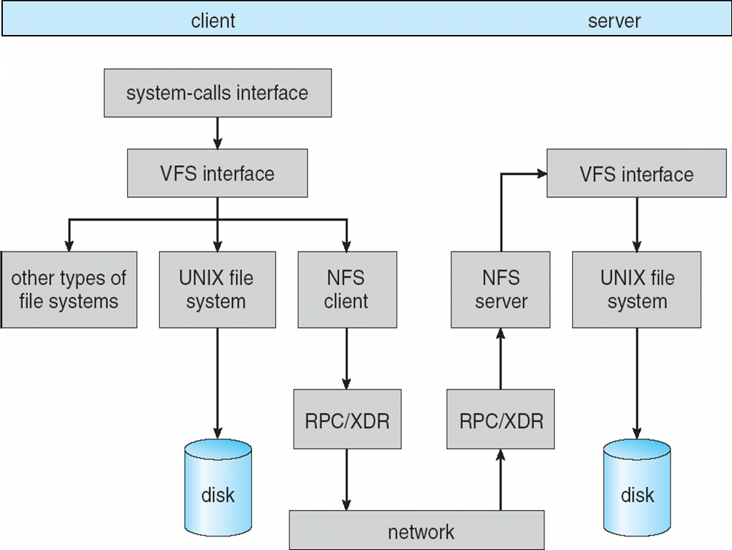
Schematic View of NFS Architecture

Slide 87
NFS Path-Name Translation
Performed by breaking the path into component names and performing a separate NFS lookup call for every pair of component name and directory vnode
For example, a path name such as /usr/loca/dir/file.txt is separated into three look up calls:
(1) usr, (2) local, and (3) dir1.
To make lookup faster, a directory name lookup cache on the client’s side holds the vnodes for remote directory names

Slide 88
NFS Cache consistency
NFS protocol: weak consistency
Client polls server periodically to check for changes
Polls server if data hasn’t been checked in last 3-30 seconds (exact timeout it tunable parameter).
Thus, when file is changed on one client, server is notified, but other clients use old version of file until timeout.
What if multiple clients write to same file?
In NFS, can get either version (or parts of both)
Completely arbitrary!
cache
F1 still ok?
F1:V2
F1:V1
No: (F1:V2)
Client
Write (RPC)
Server
cache
F1:V2
ACK
cache
F1:V2
Client

Slide 89
NFS remote operations & Consistency
Caches are used to improve performance.
Tuning the system for performance makes it difficult to characterize the semantics of NFS:
New files created on a machine may not be visible elsewhere for 30 seconds.
Writes to a file at one site may or may not be visible at other sites what have this file open for reading.
New opens of a file observe only the changes that have already been flsuhed to the server.

Slide 90
NFS Pros and Cons
NFS Pros:
Simple, Highly portable
NFS Cons:
Sometimes inconsistent!
Doesn’t scale to large # clients
Must keep checking to see if caches out of date
Server becomes bottleneck due to polling traffic

Slide 91
Revisiting Block vs. File vs. Object storage

Slide 92
Block Storage
A block is a raw storage volume filled with files that have been split into chunks of data of equal size.
A server-based operating system manages these volumes and can use them as individual hard drives.
perform a number of functions native to individual OS platforms.
Ideal for performance-intensive primary storage
No metadata: there are no additional details associated with a block outside of its address.

Slide 93
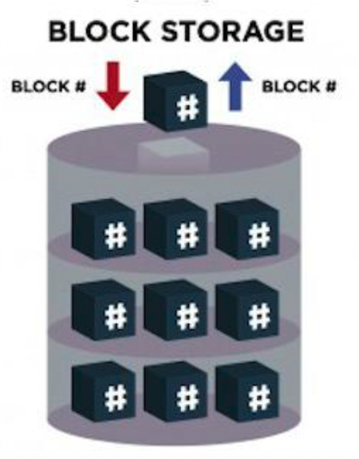
How Block Storage is Organized
Data is typically stored on device in fixed-sized blocks (e.g. 512 Bytes)
Data is stored without any higher-level metadata
e.g. for data format, type or ownership
Accessed by operating system as mounted drive volume
Applications/file systems decide how blocks are accessed, combined, and modified

Slide 94
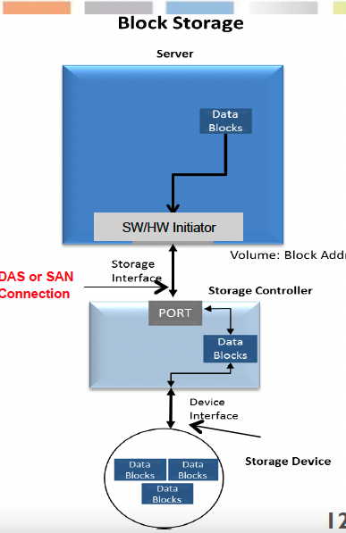
How block storage is Accessed
Application writes data block
Block goes to SW/HW Initiator and over DAS* or SAN** connections
DAS: SATA, SAS, FC, NVMe™
Ethernet SAN: iSCSI, NVMe-oF
Fibre Channel SAN: FCP, NVMe-oF
Storage controller receives block
Data written to device as data block

Slide 95
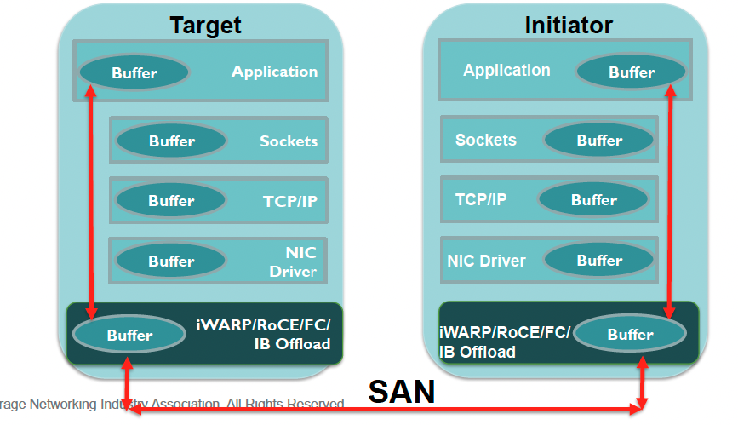
Block Storage I/O Path

Slide 96
Managing Block Storage
Block storage devices (represented by Volumes) provide their capacity to external applications through block-based protocols
Standard APIs used for management of resources providing access to block storage
Block storage management functions include
Add volume, Allocate volume, Expand storage volume,
Review volume metrics
Create storage group, Create storage pool
Create class of service, Discover class of service,
Get capacity by class of service, Find storage service
Create line of service, List supported line of service options

Slide 97
Block Storage Use Cases
Databases: Block storage is common in databases and other mission-critical applications that demand consistently high performance.
Email servers: Block storage is the defacto standard for Microsoft’s popular email server Exchange, which doesn’t support file or network-based storage systems.

Slide 98
Object Storage
Object storage, as a definition, is a storage system that manages and manipulates data storage as distinct units, called objects.
Flat address structure: all you need is that key (or object ID) to access the object
You can retrieve an object from storage by simply presenting its unique ID, thus making information much easier to find in a large pool of data. The data could be physically stored on a local server, or a remote server thousands of miles away in the cloud
Operating system effectively removed from consumption of the storage.
All object storage solutions are accessible via a RESTful interface over HTTP

Slide 99
Objects in Object Storage
Objects have a handle that is a URL, or ObjectID (both)
Objects may be grouped into flat buckets or hierarchical containers (also with URLs)
Objects have metadata
User metadata, system metadata
Objects may have versions
Underlying infrastructure may be immutable storage

Slide 100
Object Access
No need for a “mount” operation
Access any Object from any endpoint modulo security
Resolve the location from the URL
RESTful interfaces
Objects in a Hybrid cloud can move back and forth between private and public infrastructure transparently
Object store can utilize an underlying file system, or can organize the data itself

Slide 101
Drivers for Object-based Storage
More than 90% of the data begin generated is unstructured
Traditional solutions are inefficient to handle the growth
high overhead in NAS due to managing large number of permissions and nested directories
These challenges demanded a smarter approach to manage unstructured data based on its contents rather than metadata about its name, location, etc.

Slide 102
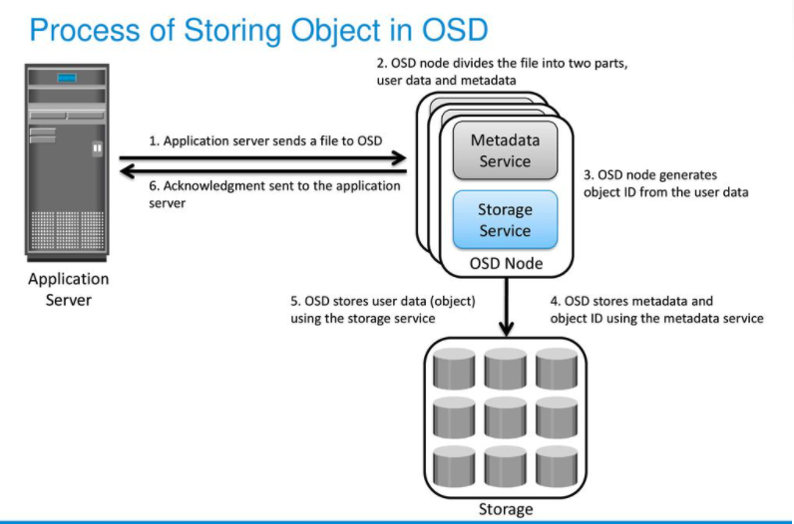
OSD: Object Storage Device

Slide 103
Object storage use cases
Big data: Object storage has the ability to accommodate unstructured data with relative ease. This makes it a perfect fit for the big data needs of organizations in finance, healthcare, and beyond.
Web apps: You can normally access object storage through an API. This is why it’s naturally suited for API-driven web applications with high-volume storage needs.
Backup archives: Object storage has native support for large data sets and near infinite scaling capabilities. This is why it is primed for the massive amounts of data that typically accompany archived backups.

Slide 104
What is NOT a good use case for Object Storage?
Running operating systems or highly transactional, low-latency,
Immediately consistent data

Slide 105
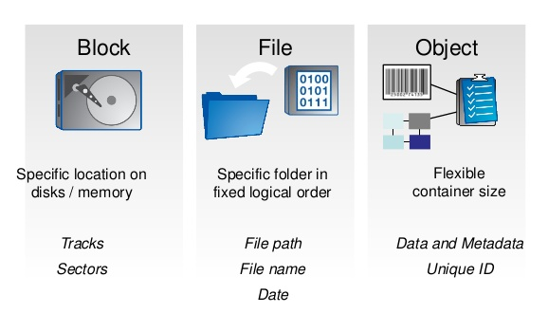

Slide 106
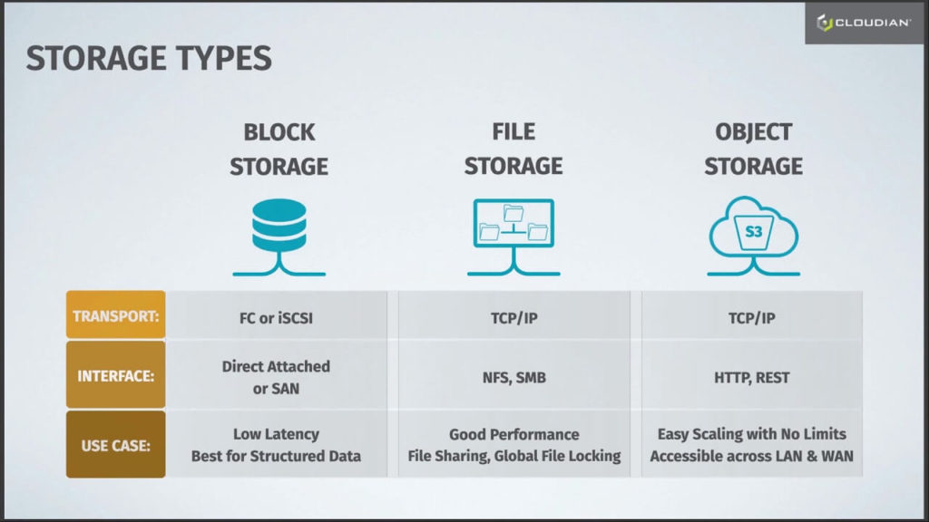

Slide 107
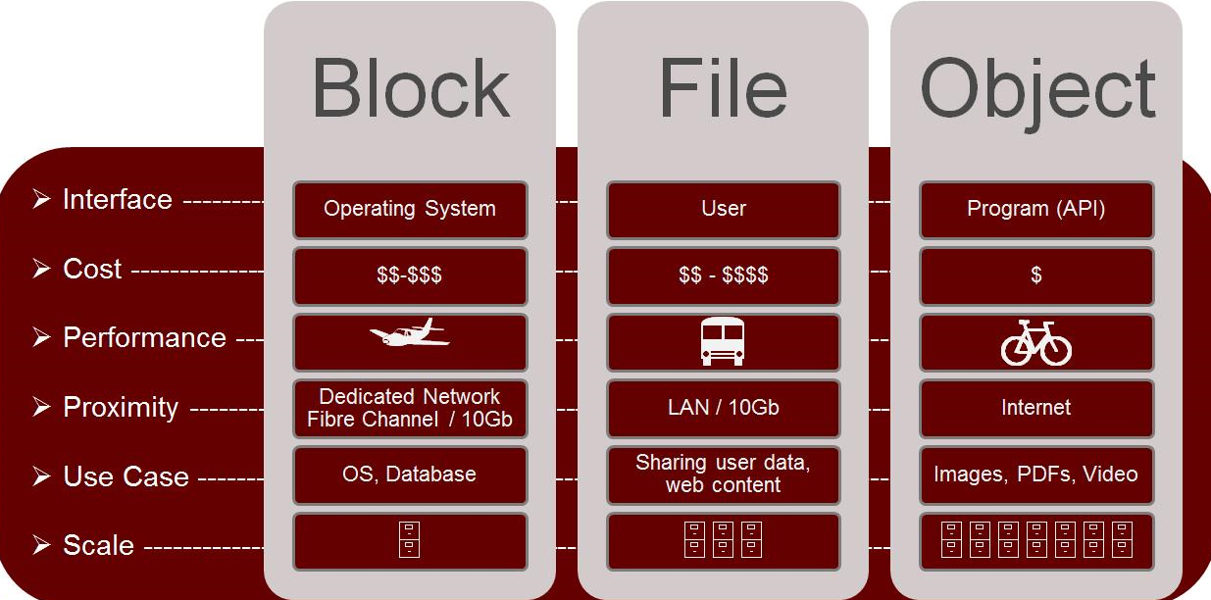

Slide 108
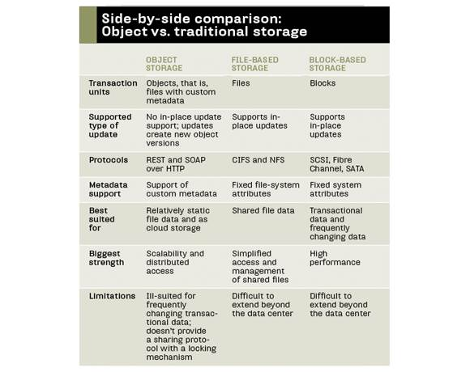

Slide 109
References
https://www.snia.org/sites/default/files/ESF/SNIA-Block-File-Object-Storage-Webcast-Final.pdf
https://youtu.be/Akpu35MKzrAhttps://slideplayer.com/slide/12774319/
https://blog.storagecraft.com/object-storage-systems/
https://apachebooster.com/blog/different-types-of-storage-object-vs-file-vs-block-storage/

